Slide 1
Drug Impairment Training for Education Professionals
(DITEP)

Slide 2

Your Instructors
Names
Agencies
Background information
DITEP – Drug Impairment Training for Education Professionals

Slide 3

DITEP – Day 1
Session I: Introduction and Overview
Session II: Drugs in Society
Session III: Overview of Alcohol
Session IV: Drug Identification, Categories and Their Observable Effects
Session V: Policies, Procedures and Contacting the Parent(s)
Session VI: References
DITEP – Drug Impairment Training for Education Professionals

Slide 4

Session I
Introductions and Overview
DITEP – Drug Impairment Training for Education Professionals

Slide 5
Goal of This Training
To enable education professionals to identify chemically impaired individuals and types of drugs for the purpose of ensuring a safe learning environment.
DITEP – Drug Impairment Training for Education Professionals

Slide 6
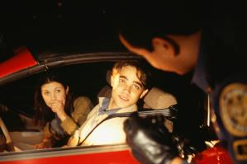
Secondary Goal
To assist in preventing an impaired student from driving to and from the school campus
DITEP – Drug Impairment Training for Education Professionals

Slide 7
What this training is NOT…
Not intended to qualify participants as drug recognition experts (DREs)
Not designed as an enforcement tool. The information and procedures provided are for administrative purposes only
DITEP – Drug Impairment Training for Education Professionals

Slide 8
Objectives
Understand the goals of DITEP training
Understand how DITEP can assist in identifying drug-impaired students
Properly recognize and describe drug impairment indicators
DITEP – Drug Impairment Training for Education Professionals

Slide 9
Other Objectives
Understand the involvement of drugs in schools and society
Discuss the seven drug categories and their signs and indicators of impairment
DITEP – Drug Impairment Training for Education Professionals

Slide 10
Other Objectives
Identify the key factors to be considered when discussing substance abuse with a parent
Properly interpret and document the results of your observations
Understand how to make referrals to the appropriate resources
DITEP – Drug Impairment Training for Education Professionals

Slide 11

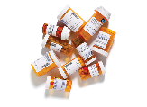

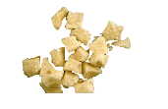

What is a Drug?
Any substance that alters perception or behavior, reducing that individual’s ability to function appropriately in the academic environment.
DITEP – Drug Impairment Training for Education Professionals

Slide 12

All terminology and information is based on medical and scientific facts and research
Signs, symptoms and indicators presented have been validated in both laboratory and field studies
DITEP – Drug Impairment Training for Education Professionals

Slide 13
Standardized and Systematic
The goal is to identify those who may be impaired by a drug or drugs to:
  Improve the learning environment,
  Provide early intervention and diversion, and
  Assess the need for medical treatment
Based on the totality of the information
DITEP – Drug Impairment Training for Education Professionals

Slide 14


Test Your Knowledge Time
DITEP – Drug Impairment Training for Education Professionals

Slide 15
True or False?
Marijuana is one the most frequently abused drugs in schools today?
TRUE
2. People under the influence of methamphetamine will exhibit constricted pupils?
FALSE
DITEP – Drug Impairment Training for Education Professionals

Slide 16
True or False?
3. Synesthesia is an indicator of hallucinogen drug use?
TRUE
4. “DXM” is a street name for dextromethorphan?
TRUE
DITEP – Drug Impairment Training for Education Professionals

Slide 17
True or False?
5. U.S. citizens consume approximately 40% of the world’s prescription drugs?
TRUE
6. An addicted heroin user will usually inject heroin 4-6 times each day?
TRUE
DITEP – Drug Impairment Training for Education Professionals

Slide 18
True or False?
7. The effects of drugs on the user are independent of the user’s personality, the environment, or how the drug was introduced?
TRUE
8. Cannabis causes an increased pulse rate?
TRUE
DITEP – Drug Impairment Training for Education Professionals

Slide 19
True or False?
9. If a person’s blood alcohol level is 0.08%, it will take approximately 2 hours of non-drinking to eliminate all alcohol and achieve a 0.00% blood alcohol level?
FALSE
10. Alcohol lowers inhibitions, therefore it is best classified as a stimulant?
FALSE
DITEP – Drug Impairment Training for Education Professionals

Slide 20
True or False?
11. Most people abuse only one type of drug (their drug of choice) while usually not abusing other types of drugs?
FALSE
12. A person impaired by Xanax will appear similar to one intoxicated by alcohol?
TRUE
DITEP – Drug Impairment Training for Education Professionals

Slide 21
True or False?
13. Generally, injection is the fastest way for a drug to reach the brain?
FALSE
14. Marijuana impairs a person’s attention span for normally not more than two hours after use?
FALSE
DITEP – Drug Impairment Training for Education Professionals

Slide 22

True or False?
15. Pupils of different sizes is an indicator of drug impairment?
FALSE
DITEP – Drug Impairment Training for Education Professionals

Slide 23

END OF SESSION I
DITEP – Drug Impairment Training for Education Professionals

Slide 24
SESSION II -
Drugs In Society

Slide 25
(NSDUH) Self-Reported Drug Use
In 2021, an estimated 61.2 million Americans (21.9 percent of the population) aged 12 or older used illicit drugs in the past year
Most commonly used illicit drug was marijuana, at 52.5 million users
DITEP – Drug Impairment Training for Education Professionals
Notes:
The following summarizes the self-reported drug usage information as reported by the 2022 NSDUH Report, January 2023.
Remind the participants the numbers are very conservative due to self-reporting.

Slide 26
Prescription Drug Use
Adolescent non-medical drug use
Tranquilizers
103,000
Pain relievers
169,000
655,000
41,000
Stimulants
467,000
Sedatives
Psychotherapeutics
  (Source: National Survey on Drug Use and Health)

Slide 27
Prescription Drug Abuse/Misuse
Three classes of prescription drugs commonly abused:
Opioids, or Narcotic Analgesics - Most often prescribed to treat pain (Oxycodone, Hydrocodone, Morphine, etc.)
Central Nervous System (CNS) Depressants - Used to treat anxiety and sleep disorders (Xanax, Ambien, Valium, etc.)
CNS Stimulants - Prescribed to treat the sleep disorder narcolepsy and attention-deficit hyperactivity disorder (Amphetamines, Adderall, etc.)
DITEP – Drug Impairment Training for Education Professionals

Slide 28
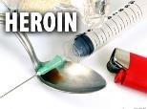
National Statistics
There were an estimated 2.5 million current abusers of prescription narcotic analgesics and over half a million heroin users (2020)
There are approximately 5.2 current (within the last month) cocaine users aged 12 and older in the U.S. (2020)
5.1 million persons reported non-medical use of prescription stimulants, and 2.5 million reported using methamphetamine
(Source: 2021 National Survey on Drug Use and Health)
DITEP – Drug Impairment Training for Education Professionals

Slide 29
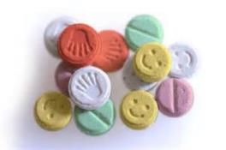
National Statistics
In 2020, an estimated 7.1 million people reported using hallucinogens within the last year
Two most frequently abused were LSD and Ecstasy
(Source: SAMHSA 2021)
DITEP – Drug Impairment Training for Education Professionals

Slide 30
National Statistics
Apart from alcohol, marijuana is the most commonly abused drug in the U.S.
There were 32.8 million Americans over the age of 12 reporting marijuana use in the past month (2020)
Source: SAMHSA, 2021
DITEP – Drug Impairment Training for Education Professionals

Slide 31
Teen Alcohol Consumption
  15% of 8th graders report consuming alcohol in the past year, down 31% proportionally from 22% in 2013
  Nearly one in three (31%) of 10th graders report consuming alcohol in the past year, a decrease of 34% proportionally from 47% in 2013
  12th graders reported annual consumption rate increased significantly from 2021, however, the prevalence rate of annual consumption among high school seniors has declined 16% proportionally from 62% in 2013 to 52% in 2022
(Source: NIDA, National Survey Results on Drug Use, 2022 Monitoring the Future Study)
DITEP – Drug Impairment Training for Education Professionals

Slide 32
Causes of Death for Teens
#1 - Motor vehicle crashes for 16 - 19 year-olds
Every day, six teens in the 16 -19 year-old age group die from motor vehicle crashes
Per mile driven, teens are nearly 3 times more likely than drivers over age 20 to be in a fatal crash
(Source: Centers for Disease Control and Prevention)
DITEP – Drug Impairment Training for Education Professionals

Slide 33
State and Local Statistics
Drug usage trends
Common drugs of abuse
New drugs of abuse
DITEP – Drug Impairment Training for Education Professionals

Slide 34

“Generational Forgetting”
Many drugs make a comeback years after they decreased in popularity, often times because young people’s knowledge of the drugs adverse consequences faded as generational replacement took place.
Dangers of “out of fashion drugs”
DITEP – Drug Impairment Training for Education Professionals

Slide 35



Drugs and the Internet
DITEP – Drug Impairment Training for Education Professionals

Slide 36
DITEP Program Development
In 1996, President Clinton pledged support to programs to reduce drug-impaired teen driving
Arizona, Kansas, and New York began training school personnel to identify impaired students
IACP worked with these states to further develop and expand the training program
DITEP – Drug Impairment Training for Education Professionals

Slide 37

END OF SESSION II
DITEP – Drug Impairment Training for Education Professionals

Slide 38
Session III -
Overview of Alcohol

Slide 39

Alcohol Facts
CNS Depressant drug, despite an
initial feeling of energy
Most abused drug in the United States
In 2021, 3.2 million youth ages 12 to 20 reported binge drinking at least once in the past month (National Survey on Drug Use and Health, 2023)
DITEP – Drug Impairment Training for Education Professionals

Slide 40
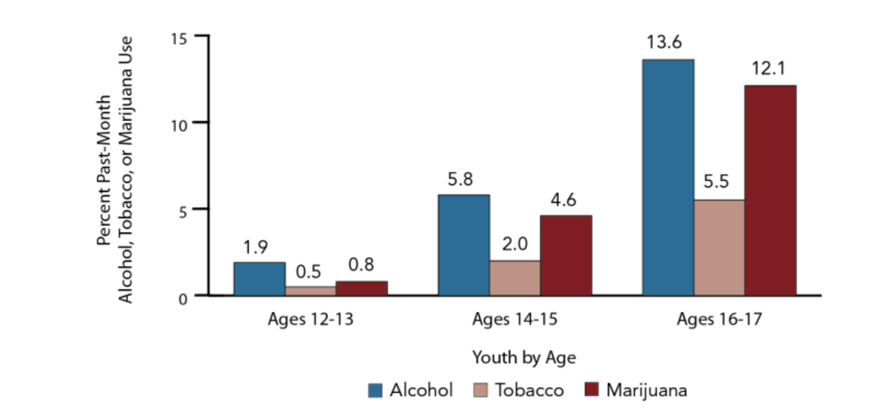
Adolescents Use of Alcohol Compared to Tobacco and Marijuana
DITEP – Drug Impairment Training for Education Professionals
Source: 2021 NSDUH, Accessed Jan 2023

Slide 41

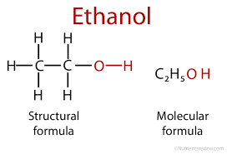

Physiology of Alcohol
A family of closely-related chemicals whose molecules are made up of hydrogen, carbon, and oxygen.
DITEP – Drug Impairment Training for Education Professionals

Slide 42

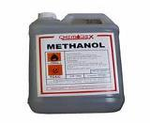

Some Types of Alcohol
Ethyl Alcohol (Ethanol)
Methyl Alcohol (Methanol)
Isopropyl Alcohol (Isopropanol)
DITEP – Drug Impairment Training for Education Professionals
Notes:
Ask the question: What are the names of some of the chemicals that are alcohols?
Three of the more commonly known alcohols are Methyl, Ethyl, and Isopropyl.
• Methyl alcohol also known as Methanol or wood alcohol
• Ethyl alcohol also known as Ethanol or beverage alcohol
• Isopropyl Alcohol (Isopropanol) also known as rubbing alcohol

Slide 43

Ethanol Production - Fermentation
Yeast combines with sugars from fruit or grains in a chemical reaction resulting in ETOH.
DITEP – Drug Impairment Training for Education Professionals
Notes:
Ethanol is what interests us because it is the kind of alcohol that features prominently in impaired driving. Ethanol is beverage alcohol, the active ingredient in beer, wine, whiskey, liquors, etc. Ethanol production starts with fermentation. That is a kind of decomposition in which the sugars in fruit, grains, and other organic materials combine with yeast to produce the chemical we call ethanol. This can occur naturally, as yeast spores in the air come into contact with decomposing fruit and grains. However, most of the ethanol in the world didn't ferment naturally, but was produced under human supervision.
When an alcoholic beverage is produced by fermentation, the maximum ethanol content that can be reached is about 14%. At that concentration, the yeast dies, so the fermentation stops. Obtaining a higher ethanol content requires a process called distillation. This involves heating the beverage until the ethanol "boils off," then collecting the ethanol vapor. It is possible to do this because ethanol boils at a lower temperature than does water.
Point out humans almost certainly first encountered ethanol that had been produced accidentally in this fashion.
Ask the question: "Why can't fermentation produce a higher ethanol concentration than 14%?” .
Point out ethanol starts to boil at a lower temperature than water does.

Slide 44

Ethanol Production - Distillation
Fermented beverage is boiled at a controlled temperature to extract and concentrate the ethanol fumes.
DITEP – Drug Impairment Training for Education Professionals
Notes:
Ask participants to name some distilled spirits (whiskey, vodka, gin, rum).
Distilled spirits is the name we give to high ethanol concentration beverages produced by distillation. These include rum, whiskey, gin, vodka, etc. The ethanol concentration of distilled spirits usually is expressed in terms of proof, which is a number corresponding to twice the ethanol percentage.
For example, an 80-proof beverage has an ethanol concentration of 40%.

Slide 45

Standard-Sized Drinks
Standard drinks in the U.S. by ounce and percent of alcohol
DITEP – Drug Impairment Training for Education Professionals

Slide 46
Absorption of Alcohol
Stomach Walls
Stomach Walls
Getting the ethanol out of the stomach and into the blood
20%
Pylorus
Stomach Walls
80%
DITEP – Drug Impairment Training for Education Professionals

Slide 47

Distribution of Alcohol
Getting the ethanol into the body’s tissues and organs
BASIC PRINCIPLE
Ethanol goes wherever it finds water
DITEP – Drug Impairment Training for Education Professionals
Notes:
Once the alcohol moves from the stomach into the blood, it will be distributed throughout the body by the blood. Alcohol has an affinity for water. The blood will carry the alcohol to the various tissues and organs of the body and will deposit the alcohol in them in proportion to their water contents.
Brain tissue has a fairly high water content so the brain receives a substantial share of the distributed alcohol. Muscle tissue also has a reasonably high water content but fat tissue contains very little water. Thus, very little alcohol will be deposited in the drinker's body fat. This is one factor that differentiates alcohol from certain other drugs, notably PCP and THC, which are very soluble in fat.

Slide 48

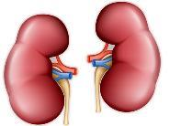
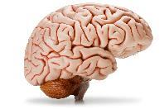
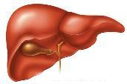
Which Body Parts Contain a Lot of Water?
Brain Liver Muscle Tissue Kidneys
Which body parts contain very little water?
Bones and Fatty Tissue
DITEP – Drug Impairment Training for Education Professionals

Slide 49
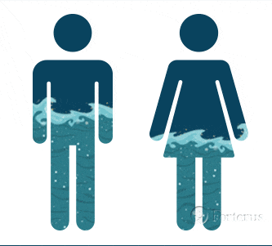
Alcohol Facts by Gender
DITEP – Drug Impairment Training for Education Professionals

Slide 50


Elimination of Alcohol
Getting the ethanol out of the body:
Direct excretion
  Breath
  Urine
  Sweat, Tears
  Etc.
Metabolism (Liver)
DITEP – Drug Impairment Training for Education Professionals
Notes:
As soon as the alcohol enters the blood stream, the body starts trying to get rid of it. Some of the alcohol will be directly expelled from the body chemically unchanged. For example, some alcohol will leave the body in the breath, urine, sweat, tears, etc. However, only a small portion (about 2-10%) of the ingested alcohol will be directly eliminated.
Most of the alcohol a person drinks is eliminated by metabolism. Metabolism is a process of chemical change. In this case, alcohol reacts with oxygen in the body and changes through a series of intermediate steps into carbon dioxide and water, both of which are directly expelled from the body.
Ask the question: What organ in the body is primarily responsible for chemically breaking the alcohol down?
Click to reveal answer to question on next slide.

Slide 51



DITEP – Drug Impairment Training for Education Professionals

Slide 52

END OF SESSION III
DITEP – Drug Impairment Training for Education Professionals

Slide 53
Session IV -
Drug Identification, Categories and Their Observable Effects

Slide 54
Session Four - Objectives
Define the word “drug” and other terms associated with drug impairment
For each of the seven drug categories:
- Identify common drug types
- Discuss the different signs of ingestion
- Identify the general indicators of impairment
DITEP – Drug Impairment Training for Education Professionals

Slide 55
Session Four - Objectives
Identify the effect of impairment on pupil size
Become familiar with overdose symptoms of the drug categories
Become familiar with some of the medical conditions that may mimic drug impairment
DITEP – Drug Impairment Training for Education Professionals

Slide 56
Definition of a Drug
Any substance that alters perception or behavior, reducing that individual’s ability to function appropriately in the academic environment.
DITEP – Drug Impairment Training for Education Professionals

Slide 57
Seven Drug Categories
Central Nervous System (CNS) Depressants
CNS Stimulants
Hallucinogens
Dissociative Anesthetics
Narcotic Analgesics
Inhalants
Cannabis
DITEP – Drug Impairment Training for Education Professionals

Slide 58

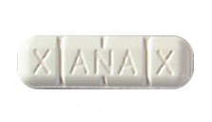
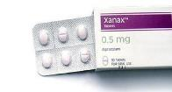
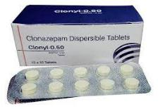

Central Nervous System (CNS) Depressants
DITEP – Drug Impairment Training for Education Professionals

Slide 59

Most Familiar CNS Depressant - Alcohol
DITEP – Drug Impairment Training for Education Professionals
DITEP – Drug Impairment Training for Education Professionals

Slide 60
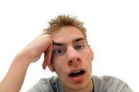
General Impairment Indicators
- Drowsy acting
- Thick slurred speech
- Uncoordinated
- Flaccid muscle tone
- Sluggish acting
- Droopy eyelids
- Bloodshot, watery eyes
- Slowed reflexes
- Poor balance and coordination
DITEP – Drug Impairment Training for Education Professionals

Slide 61

Conditions That May Mimic CNS Depressant Impairment
Extreme fatigue
Head injury
Hypotension (low blood pressure)
Severe depression
Diabetic reaction
Inner ear disorders
DITEP – Drug Impairment Training for Education Professionals

Slide 62

https://www.youtube.com/watch?v=pmJmMajwArY
DITEP – Drug Impairment Training for Education Professionals

Slide 63

CNS Depressant Overdose Symptoms
- Shallow breathing
- Clammy skin
- Rapid weak pulse
- Coma
DITEP – Drug Impairment Training for Education Professionals

Slide 64

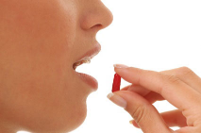
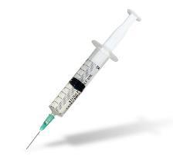
Methods of Ingestion
- Oral - Primary method of ingestion
- Injected
DITEP – Drug Impairment Training for Education Professionals

Slide 65

Duration of Effects
Depending on the type of depressant, the effects can last from a few minutes to approximately fourteen hours.
DITEP – Drug Impairment Training for Education Professionals

Slide 66

Questions Regarding
CNS Depressants?
DITEP – Drug Impairment Training for Education Professionals

Slide 67
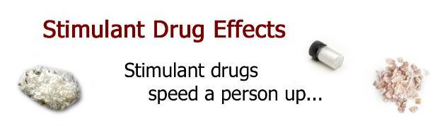
CNS Stimulants
DITEP – Drug Impairment Training for Education Professionals

Slide 68
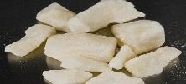
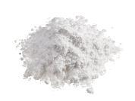
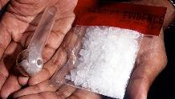

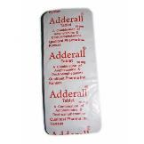
Various CNS Stimulants
- Cocaine / Crack
- Amphetamines
- Methamphetamine
- Prescription “General Cellular” Stimulants
- Herbal and Over-the-Counter Stimulants
DITEP – Drug Impairment Training for Education Professionals

Slide 69
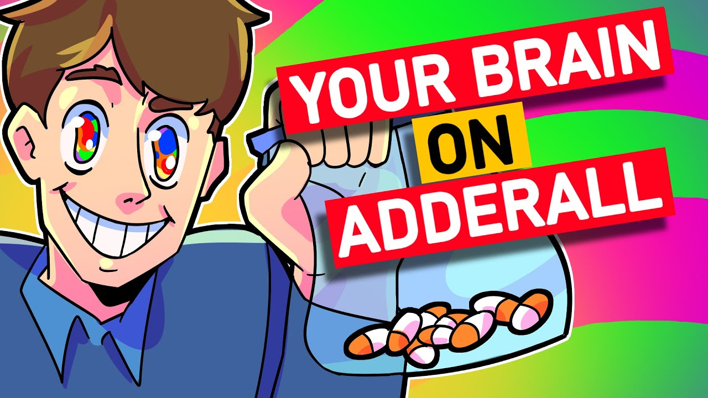
https://www.youtube.com/watch?v=ifutqKQ6KQE
DITEP – Drug Impairment Training for Education Professionals

Slide 70

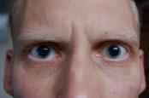
General Impairment Indicators
- Restlessness - Body tremors
- Anxiety - Grinding teeth (Bruxism)
- Excited - Exaggerated reflexes
- Runny nose - Talkative
- Paranoia - Euphoria
- Dry mouth - Irritability
- Loss of appetite - Loss of weight
- Dilated pupils
DITEP – Drug Impairment Training for Education Professionals

Slide 71

Conditions That May Mimic CNS Stimulant Symptoms
- Hyperactivity
- Nervousness
- Stress
- Fear
- Hypertension (high blood pressure)
DITEP – Drug Impairment Training for Education Professionals

Slide 72

CNS Stimulant Overdose Symptoms
- Confusion
- Feelings of pleasure to panic
- Convulsions
- Fainting
- Aggressiveness
- Dramatic increase in heart rate
- Hallucinations
- Coma
DITEP – Drug Impairment Training for Education Professionals

Slide 73

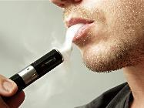
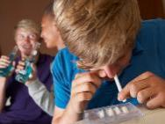

Methods of Ingestion
Oral
Smoking
Snorting
Injecting
DITEP – Drug Impairment Training for Education Professionals

Slide 74

Duration of Effects
Cocaine
- 5 to 10 minutes (smoked)
- 45 to 90 minutes (injected)
Amphetamines Methamphetamine
- 4 to 8 hours - 12 hours
Adderall / Dexedrine – Varies
DITEP – Drug Impairment Training for Education Professionals

Slide 75

Questions Regarding
CNS Stimulants?
DITEP – Drug Impairment Training for Education Professionals

Slide 76
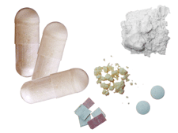
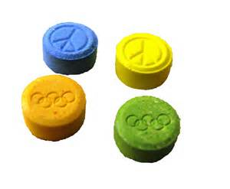
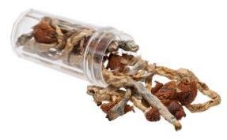
Hallucinogens
DITEP – Drug Impairment Training for Education Professionals

Slide 77

Hallucinogens
Drugs that affect a person’s perceptions, sensations, thinking, self-awareness and emotions.
Can cause the user to perceive things differently from what they actually are.
Can cause a mixing or transposition of the senses, known as Synesthesia.
DITEP – Drug Impairment Training for Education Professionals

Slide 78
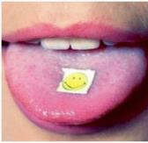
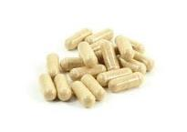
Synthetic Hallucinogens
LSD
MDMA (Ecstasy)
Designer Psychedelics
DITEP – Drug Impairment Training for Education Professionals
Notes:
Hallucinogens
Hallucinogens are drugs that affect a person’s perceptions, sensations, thinking, self awareness, and emotions.
Definition from The Random House College Dictionary (Revised Edition, 1980).
One common type of hallucination caused by these drugs is called synesthesia, which means a transposing of the senses.
Sounds, for example, may be transposed into sights.
Example: the user may “see” a flash of color whenever the telephone rings.
Sights, for example, may be transposed into odors or sounds.
Example: the user may “smell” a particular fragrance when he or she looks at something painted red.
Some hallucinogenic drugs come from natural sources:
Peyote is a Hallucinogen found in a particular species of cactus
Psilocybin is a Hallucinogen found in a number of species of mushroom
Other Hallucinogens are synthetically manufactured:
LSD (Lysergic Acid Diethylamide)
MDA (3,4-Methylenedioxyamphetamine)
MDMA (3,4-Methylenedioxymethamphetamine or Ecstasy)
Many others

Slide 79
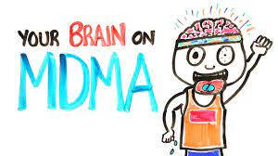
https://www.youtube.com/watch?v=jEAr7ThsYew
DITEP – Drug Impairment Training for Education Professionals

Slide 80


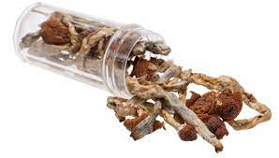
Natural Hallucinogens
Salvia Divinorum
Peyote
Psilocybin
Morning Glory Sees
DITEP – Drug Impairment Training for Education Professionals
Notes:
Hallucinogens
Hallucinogens are drugs that affect a person’s perceptions, sensations, thinking, self awareness, and emotions.
Definition from The Random House College Dictionary (Revised Edition, 1980).
One common type of hallucination caused by these drugs is called synesthesia, which means a transposing of the senses.
Sounds, for example, may be transposed into sights.
Example: the user may “see” a flash of color whenever the telephone rings.
Sights, for example, may be transposed into odors or sounds.
Example: the user may “smell” a particular fragrance when he or she looks at something painted red.
Some hallucinogenic drugs come from natural sources:
Peyote is a Hallucinogen found in a particular species of cactus
Psilocybin is a Hallucinogen found in a number of species of mushroom
Other Hallucinogens are synthetically manufactured:
LSD (Lysergic Acid Diethylamide)
MDA (3,4-Methylenedioxyamphetamine)
MDMA (3,4-Methylenedioxymethamphetamine or Ecstasy)
Many others

Slide 81


General Impairment Indicators
- Hallucinations
- Body tremors
- Paranoia
- Uncoordinated
- Nausea
- Disoriented
- Dilated pupils
- Perspiring
- Memory loss
- Dazed appearance
- Flashbacks
- Difficulty with speech
- Synesthesia
DITEP – Drug Impairment Training for Education Professionals

Slide 82

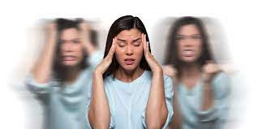
Conditions That May Mimic Hallucinogen Symptoms
- Mental illness
- High fever
DITEP – Drug Impairment Training for Education Professionals

Slide 83

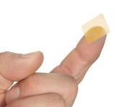
Methods of Ingestion
Smoked
Oral
Transdermal Absorption
Snorted
Injected
DITEP – Drug Impairment Training for Education Professionals

Slide 84
Duration of Effects
LSD
6 – 8 hours
Peyote Psilocybin
10 – 12 hours Up to 12 hours
MDMA (Ecstasy) – 1 to 3 hours
DITEP – Drug Impairment Training for Education Professionals

Slide 85

Questions Regarding
Hallucinogens?
DITEP – Drug Impairment Training for Education Professionals

Slide 86
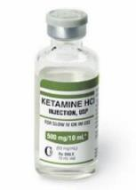
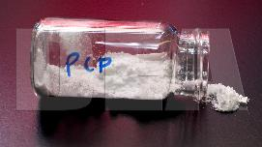

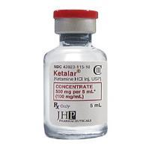
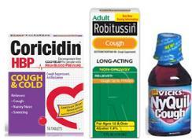
Dissociative Anesthetics
DITEP – Drug Impairment Training for Education Professionals

Slide 87
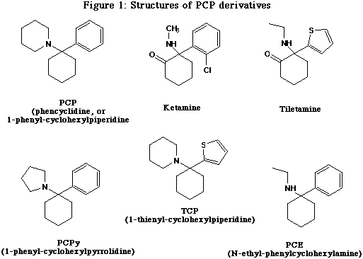
PCP and Its Analogs
Phencyclidine is a shortened form of the chemical name PhenylCyclohexylPiperidine or PCP
DITEP – Drug Impairment Training for Education Professionals

Slide 88

General Impairment Indicators
- Blank stare - Agitation
- Loss of memory - Rigid muscle tone
- Confused - Non-responsive
- Perspiring heavily - Slowed responses
- Incomplete, slurred verbal responses
DITEP – Drug Impairment Training for Education Professionals

Slide 89
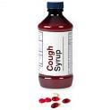




Dextromethorphan - (DXM)
Plateau Effects
Normal liquid is 2mg/ml - Pills 30 mg per tablet
4th Plateau
4th
Mind-body dissociation
4
4th Plateau
3rd Plateau
3rd
Altered
state of
conscious-
ness
3
3rd Plateau
2nd Plateau
2nd
2
2nd Plateau
Mild hallucinations
1st Plateau
1st Plateau
1
1st
Mild inebriation
DITEP – Drug Impairment Training for Education Professionals

Slide 90

Overdose Signs and Symptoms
- Deep coma, lasting up to 12 hours
- Seizures and convulsions
- Respiratory depression
- Possible cardiac problems
- Bizarre, violent, and self-destructive behavior
DITEP – Drug Impairment Training for Education Professionals

Slide 91
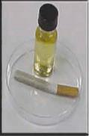

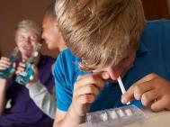
Methods of Ingestion
Smoking
Oral
Transdermal absorption
Snorting
Injecting
DITEP – Drug Impairment Training for Education Professionals

Slide 92

Duration of Effects
Onset Duration
PCP: 1-5 min 4-6 hours
Ketamine: 1-5 min Up to 2 hours
DXM: Rapidly absorbed 3-6 hours
DITEP – Drug Impairment Training for Education Professionals

Slide 93

Questions Regarding
Dissociative Anesthetics
DITEP – Drug Impairment Training for Education Professionals

Slide 94
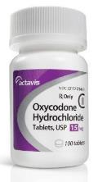
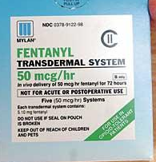
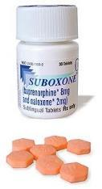
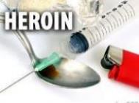
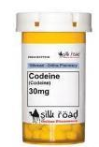
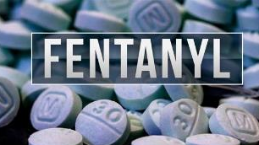

Narcotic Analgesics
DITEP – Drug Impairment Training for Education Professionals

Slide 95

Tolerance
Occurs when the same dose of the drug will produce diminishing
effects. The user will need an
increasing dose of the drug
to achieve the same effect.
DITEP – Drug Impairment Training for Education Professionals

Slide 96


Narcotic Analgesics
Opiates: Drugs that either contain or are derived from opium
Opioids: Drugs not derived from opium but produce similar or identical effects. Includes many synthetically produced drugs
DITEP – Drug Impairment Training for Education Professionals

Slide 97


- Two types of fentanyl: pharmaceutical and illicitly manufactured
- Both are considered synthetic opioids
Pharmaceutical fentanyl is prescribed by doctors to treat severe pain, especially after surgery and for advanced-stage cancer
DITEP – Drug Impairment Training for Education Professionals

Slide 98



In 2021, more than 71,000 people died from synthetic opioid-related drug overdose in the United States
Synthetic opioid that is up to 50 times stronger than heroin and 100 times stronger than morphine. Fentanyl is a major contributor to drug overdose deaths. Based on preliminary 2021 data, there were 6,843 opioid-related overdose deaths in California; 5,722 of these deaths were related to fentanyl. In 2021, there were 224 fentanyl-related overdose deaths among teens, ages 15–19 years old, in California.
Recently, brightly colored fentanyl, referred to as “rainbow” fentanyl , has begun circulating in illegal markets. “Rainbow” fentanyl can be found in many forms, including pills, powders, and blocks that can resemble sidewalk chalk or candy. Regardless of appearance or color, any pill that does not come from a health care provider or pharmacist could contain fentanyl and be deadly
Fentanyl
- In 2021, more than 71,000 died from synthetic opioid-related drug overdose in the U.S.
- 50 times stronger than heroin and 100 times stronger than morphine
- Many illicit forms and being “cut” with numerous other dangerous substances
DITEP – Drug Impairment Training for Education Professionals

Slide 99

https://www.youtube.com/watch?v=C0tW8FWBm1g
DITEP – Drug Impairment Training for Education Professionals

Slide 100


Kratom (Mitragynine)
High doses: Opioid-like effects
Low doses: Stimulant-like effects
Recreationally used to increase energy, sociability, and produce feelings of happiness, well-being, relaxation and euphoria.
DITEP – Drug Impairment Training for Education Professionals

Slide 101



General Impairment Indicators
- Injection marks (“Track marks”)
- “On the nod”
- Slowed reflexes
- Low, slow, raspy speech
- Constricted pupils
- Facial itching
- Dry mouth
- Euphoria
- Flaccid muscle tone
DITEP – Drug Impairment Training for Education Professionals
DITEP – Drug Impairment Training for Education Professionals

Slide 102

Generalized Effects
- Euphoria
- Relief from pain
- Relief from the symptoms of withdrawal
DITEP – Drug Impairment Training for Education Professionals

Slide 103

Conditions with Similar Symptoms
- Extreme fatigue
- Head injury
- Hypotension (Abnormally low BP)
- Severe depression
- Diabetic reaction (insulin shock)
DITEP – Drug Impairment Training for Education Professionals

Slide 104

Overdose Signs and Symptoms
- Slow and shallow breathing
- Clammy skin
- Bluish colored lips
- Pale or blue body
- Extremely constricted pupils
DITEP – Drug Impairment Training for Education Professionals

Slide 105


Methods of Ingestion
- Injected
- Smoked
- Snorted
- Oral
- Suppositories
- Transdermal
DITEP – Drug Impairment Training for Education Professionals

Slide 106

Duration of Effects
Drug Onset Duration
Heroin
Methadone
Fentanyl
5-30 minutes
5-30 minutes
5-15 minutes
4-6 hours
Up to 24 hours
2-3 hours
DITEP – Drug Impairment Training for Education Professionals

Slide 107

Questions Regarding
Narcotic Analgesics
DITEP – Drug Impairment Training for Education Professionals

Slide 108





Inhalants
DITEP – Drug Impairment Training for Education Professionals

Slide 109



Common Inhalant Types
Volatile solvents (gasoline, paint thinner)
Aerosols (hair spray, keyboard cleaner)
Anesthetic gases (Ether, Nitrous Oxide)
DITEP – Drug Impairment Training for Education Professionals

Slide 110

General Impairment Indicators
Odor of inhaled substance
Dizziness, numbness
Traces of substance around the face and nose
Bloodshot, watery eyes
Distorted perception, time and space
DITEP – Drug Impairment Training for Education Professionals

Slide 111

More General Indicators
Inebriation much like alcohol intoxication
Intense headaches
Nausea
Possible hallucinations
Slurred speech
DITEP – Drug Impairment Training for Education Professionals

Slide 112

Conditions with Similar Symptoms
- Severe head injury
- Inner ear disorders
DITEP – Drug Impairment Training for Education Professionals

Slide 113




Methods of Ingestion
DITEP – Drug Impairment Training for Education Professionals

Slide 114

Duration of Effects
Substance Onset Duration
Nitrates Immediate Up to 20 minutes
Nitrous Immediate 5 minutes or less
Oxide
Volatile Immediate Several hours
Solvents
DITEP – Drug Impairment Training for Education Professionals

Slide 115

Questions Regarding
Inhalants
DITEP – Drug Impairment Training for Education Professionals

Slide 116





Cannabis
DITEP – Drug Impairment Training for Education Professionals

Slide 117
Cannabis
The primary psychoactive ingredient in Cannabis: Delta-9 Tetrahydrocannabinol (THC)
DITEP – Drug Impairment Training for Education Professionals

Slide 118





Types of Cannabis
Marijuana Dabs
Hash Oil (“Honey Oil” Edibles
DITEP – Drug Impairment Training for Education Professionals
DITEP – Drug Impairment Training for Education Professionals

Slide 119

DITEP – Drug Impairment Training for Education Professionals

Slide 120


Synthetic Cannabinoids
- K2
- Spice
- Crush
- JWH-018, HU-210
- Many more
DITEP – Drug Impairment Training for Education Professionals
Notes:
Generally found as dried plant material
Leaves sprayed with lab-created chemicals
Can be crystalline substance, similar in appearance to methamphetamine
Much of it comes overseas from Asia
Originally sold in head shops, gas stations, convenience stores as herbal incense or potpourri
Most often obtained through the internet
Labeled “Not For Human Consumption”

Slide 121

“Dabbing”
Concentrated high potency form of THC
Quickest, longer lasting high with single inhalation
Single puff can give the effect of smoking numerous “joints”
Difficult to detect when using various vape pens
DITEP – Drug Impairment Training for Education Professionals
Notes:
Generally found as dried plant material
Leaves sprayed with lab-created chemicals
Can be crystalline substance, similar in appearance to methamphetamine
Much of it comes overseas from Asia
Originally sold in head shops, gas stations, convenience stores as herbal incense or potpourri
Most often obtained through the internet
Labeled “Not For Human Consumption”

Slide 122

Vapes
Battery-operated devices used to inhale an aerosol, which typically contains nicotine (though not always), flavorings, and other chemicals
Popular among teens and are now the most commonly used form of nicotine among youth in the U.S.
DITEP – Drug Impairment Training for Education Professionals
Notes:
Generally found as dried plant material
Leaves sprayed with lab-created chemicals
Can be crystalline substance, similar in appearance to methamphetamine
Much of it comes overseas from Asia
Originally sold in head shops, gas stations, convenience stores as herbal incense or potpourri
Most often obtained through the internet
Labeled “Not For Human Consumption”

Slide 123

https://www.youtube.com/watch?v=oeF6rFN9org
DITEP – Drug Impairment Training for Education Professionals

Slide 124

General Indicators
Odor of marijuana
Relaxed inhibitions
Red, bloodshot eyes
Body tremors
Disorientation
Impaired attention
Dilated pupils
DITEP – Drug Impairment Training for Education Professionals

Slide 125

Overdose Signs and Symptoms
- Acute anxiety attacks
- Paranoia
- Possible psychosis
- Excessive vomiting (Cannabinoid Hyperemesis Syndrome)
DITEP – Drug Impairment Training for Education Professionals

Slide 126

Duration of Effects
Onset Duration
Marijuana
(Smoked)
Edibles
Concentrates
Within minutes
1-3 hours
Varies
3-4 hours
Up to 8 hours
Varies
DITEP – Drug Impairment Training for Education Professionals

Slide 127

Questions Regarding
Cannabis
DITEP – Drug Impairment Training for Education Professionals

Slide 128
Drug Combinations
Polydrug use: Having two or more drug categories in the body at the same time
DITEP – Drug Impairment Training for Education Professionals

Slide 129

https://www.youtube.com/watch?v=zTeaOTkjut0
DITEP – Drug Impairment Training for Education Professionals

Slide 130
Polydrug Use
Of the Drug Recognition Expert (DRE) evaluations entered into the National DRE Data Tracking System (2022):
Approximately 37% were for polydrug usage*
* Not all states were represented – actual numbers may be higher
DITEP – Drug Impairment Training for Education Professionals

Slide 131

Effects of Drug Combinations
On Indicators of Impairment
- Null effect
- Overlapping Effect
- Additive Effect
- Antagonistic Effect
DITEP – Drug Impairment Training for Education Professionals

Slide 132


Questions Regarding Drug Combinations and Drug Symptomology Chart Review
DITEP – Drug Impairment Training for Education Professionals

Slide 133

SESSION V
Policy, Procedures, Roles and Contacting the Parent(s)

Slide 134

Review of School Policy
DITEP – Drug Impairment Training for Educational Professionals

Slide 135

Ideal School Policy
1. Prohibit unlawful drug possession
2. Prohibit abuse, illegal use, and sale of prescription drugs
3. Prohibit use of alcohol beverages on school premises
4. Prohibit being under the influence of alcohol at any school function
5. Prohibit being under the influence of any unauthorized drugs
DITEP – Drug Impairment Training for Educational Professionals

Slide 136

When You Suspect a Student Is
Using Drugs
_{1. Do Something!}
2. Understand proper use vs. impairment (There is a difference)
3. Gather as much information as possible
4. If possible, discuss your observations with others
_{5. Be discreet, don’t accuse}
DITEP – Drug Impairment Training for Educational Professionals

Slide 137

Observations and Changes
- Social and behavior changes
- Cognitive functioning
- Biological/physical symptoms
- Psychomotor agitation
- Psychomotor delay
- Emotional symptoms
- Changes in social functioning
DITEP – Drug Impairment Training for Educational Professionals

Slide 138

_{School Team Effort}
- _{Teachers}
_{- Counselors}
- Principles, Deans, Administrators
- Nurses
- SRO’s
- Law Enforcement
DITEP – Drug Impairment Training for Educational Professionals

Slide 139

First Contact
- Be familiar with signs and symptoms of alcohol or drug abuse
- Not expected to be an expert
- Don’t diagnose
- Discuss your concerns
- Provide intervention (if needed). . .
DITEP – Drug Impairment Training for Educational Professionals

Slide 140
Informal Intervention
- Avoid lecturing and admonishing
- Have a positive attitude towards the student
- Avoid judgmental responses
- Avoid medical jargon
- Be attentive, genuine and empathic
- Identify the problem
- Avoid writing during the contact
- Criticize the activity, not the student . .
DITEP – Drug Impairment Training for Educational Professionals

Slide 141

Intent Of This Training Program
- Identify drug impaired students in the school environment
- Assist students in need of help with drug use issues (Intervention)
- Assist in providing a safe school environment
- Helping to make communities safer
- Not making “Hallway Narcs” . .
DITEP – Drug Impairment Training for Educational Professionals

Slide 142

Drug-Free School Zones
A geographical area where the distribution or possession of controlled substances is penalized with a sentence or fine greater than is applicable elsewhere.
DITEP – Drug Impairment Training for Educational Professionals

Slide 143

Contacting the Parents
_{WHO will call the parent(s)?}
_{WHAT is your school policy?}
WHERE can parents go for help in your community?
DITEP – Drug Impairment Training for Educational Professionals

Slide 144

Suggestions When Talking With Parent(s)
- “We observed”. . .
- Appearances
- Describe behavior, be specific
- Express concern
DITEP – Drug Impairment Training for Educational Professionals

Slide 145

Words Which May Result in a Negative Reaction
- Diagnosed
- Drugs
- “High”
- Drunk
- Druggie
- Suspect
- Arrest
- Out of Control
- Crazy
- Jail
- Others?
DITEP – Drug Impairment Training for Educational Professionals

Slide 146

Questions Regarding
Contacting the Parents?
DITEP – Drug Impairment Training for Education Professionals

Slide 147

Drug Concealment Methods

Slide 148





Drug Stash Pockets

Slide 149


Slide 150




Drug Concealment Products

Slide 151

SESSION VI -
References
DITEP – Drug Impairment Training for Educational Professionals

Slide 152
Internet Resources
http://www.nida.nih.gov/
  Specific pages for parents and teachers about drugs of abuse, drug trends, and treatment options
http://www.erowid.org
  Pro-drug non-profit educational and harm-reduction resource site about drugs, plants, chemical and drug effects
http://www.nhtsa.dot.gov
  National Highway Traffic Safety Administration (NHTSA) site for highway safety information and statistics
http://www.ndaa.org
  Legal issues, materials explaining drug assessment procedures in lay terms
http://www.nlm.gov/medlineplus/druginformation.html
  A medical-based resource for information about drugs and herbal substances
DITEP – Drug Impairment Training for Education Professionals

Slide 153



Printed Resources
Physician’s Desk Reference
Drug Identification Bible
DEA Drugs of Abuse
The Pill Book
Uppers, Downers, All-Arounders
DITEP – Drug Impairment Training for Education Professionals

Slide 154

Questions Regarding
Drug Resources?
DITEP – Drug Impairment Training for Education Professionals

Slide 155
Day 1 Training Conclusion
Questions?
Comments?
Disagreements?
DITEP – Drug Impairment Training for Education Professionals

Slide 156
Drug Impairment Training for Education Professionals
(DITEP)
Day 2

Slide 157
DITEP – Day 2
Session VII: Eye Examinations
Session VIII: Vital Signs
Session IX: Divided Attention Testing
Session X: Drug Combinations
Session XI: Assessments
Session XII: Conclusion
DITEP – Drug Impairment Training for Education Professionals

Slide 158
Day Two Objectives
Define nystagmus and distinguish between the different types
Demonstrate the administration of the horizontal gaze nystagmus (HGN) test, vertical gaze nystagmus test, and lack of convergence tests
Demonstrate the procedures used to estimate pupil size
Explain the relationship between the eye examinations and the drug categories
DITEP – Drug Impairment Training for Education Professionals

Slide 159
Day Two Objectives
List the “average ranges” for pulse rate, blood pressure, and body temperature
Explain the relationship between the vital signs examination and the drug categories
Demonstrate the administration and evaluation of the psychophysical tests
Explain the relationship of the four types of drug combinations
Identify and explain the components of the DITEP assessment form
DITEP – Drug Impairment Training for Education Professionals

Slide 160

QUESTIONS?
DITEP – Drug Impairment Training for Education Professionals

Slide 161

Eye Examinations Session VII
DITEP – Drug Impairment Training for Education Professionals

Slide 162

The Eyes – “Windows to the Brain”
DITEP – Drug Impairment Training for Education Professionals

Slide 163

Horizontal Gaze Nystagmus
The involuntary jerking of the eyes occurring as the eyes gaze towards the side
DITEP – Drug Impairment Training for Education Professionals

Slide 164
Categories of Nystagmus
Vestibular (Inner Ear Related) Nystagmus
  - Rotational - while being spun in a circle
  - Post-Rotational - after being spun
  - Caloric - temperature differences in the ears
DITEP – Drug Impairment Training for Education Professionals

Slide 165
Categories of Nystagmus (Cont.)
Neural Nystagmus
  - Optokinetic – caused by fast moving objects
  - Physiological – natural nystagmus
- Gaze Nystagmus
    Horizontal Gaze Nystagmus
    Vertical Gaze Nystagmus
    Resting Nystagmus
DITEP – Drug Impairment Training for Education Professionals

Slide 166

Horizontal Gaze Nystagmus
- Involuntary jerking of the eyes, occurring as the eyes gaze to the side
- Presence may indicate use of certain drugs
DITEP – Drug Impairment Training for Education Professionals

Slide 167


Drug Categories
That Usually Cause HGN
CNS Depressants
Inhalants
Dissociative Anesthetics
DITEP – Drug Impairment Training for Education Professionals
Notes:
The following drug categories usually will cause LOC:
CNS Depressants
Inhalants
Dissociative Anesthetics
Cannabis
These four drug categories are often referred to as DIDC drugs.

Slide 168
Vertical Gaze Nystagmus
- Involuntary jerking of the eyes (up and down)
- Occurs when eyes gaze upward at maximum elevation
- Associated with high doses of alcohol and certain other drugs
- Drugs that cause HGN may cause VGN
DITEP – Drug Impairment Training for Education Professionals

Slide 169
Resting Nystagmus
- Jerking of the eyes as they look straight ahead
- Pathological disorder or high doses of a Dissociative Anesthetic drug
DITEP – Drug Impairment Training for Education Professionals

Slide 170
Pathological Disorders and Diseases
Nystagmus may be the result of certain pathological disorders. These include brain tumors and other brain damage or some diseases of the inner ear.
DITEP – Drug Impairment Training for Education Professionals

Slide 171

Administrative Procedures
- Glasses / Contacts
- Verbal Instructions
DITEP – Drug Impairment Training for Education Professionals

Slide 172

Administrative Procedures (Cont.)
Position the stimulus 12” - 15” slightly above eye level
Preliminary Assessment
  Equal pupil size
  Resting Nystagmus
  Equal tracking
DITEP – Drug Impairment Training for Education Professionals

Slide 173
Three Clues of HGN
1. Lack of Smooth Pursuit
Move stimulus to person’s left
It should take approximately 2 seconds to bring it to the side
Check other eye at same speed
Repeat
Two Seconds
Nose Left Side
DITEP – Drug Impairment Training for Education Professionals
Notes:
Lack of Smooth Pursuit
Reference PowerPoint graphic illustration
Lack of Smooth Pursuit occurs when the eyes jerk or bounce as they follow a smoothly moving stimulus
Check the subject’s left eye first
Move the stimulus smoothly, at a speed that requires approximately two seconds to bring the subject’s eye as far to the side as it can go
Carefully watch the subject’s left eye and determine if it is able to pursue smoothly
Move the stimulus all the way to the left, back across the subject’s face and check the right eye at the same speed
Movement of the stimulus should take approximately two seconds to move from the center of the subject’s face to the shoulder on the left side
Approximately two seconds to get back to the center
Approximately two seconds to move from the center of the subject’s face to the shoulder on the right side
Then approximately two seconds to return to the center of the subject’s face to end the first pass
Repeat the procedure until each eye has been checked twice
The stimulus should be moved in a smooth, continuous manner to best observe the eyes in motion.
Point out: the stimulus must be moved in a smooth, continuous manner without stopping at either side or the center while checking for this clue.
The two-second timing is provided based on how the eye should follow the stimulus if the subject is not impaired by alcohol and/or other drugs.

Slide 174

Lack of Smooth Pursuit
DITEP – Drug Impairment Training for Education Professionals

Slide 175
Three Clues of HGN
2. Distinct and Sustained Nystagmus at Maximum Deviation
- Move stimulus to person’s left
- Hold stimulus at corner of eye (no white showing) for at least 4 seconds
- Check other eye and hold for same length
- Repeat
At least 4 Seconds
Nose Left Side
DITEP – Drug Impairment Training for Education Professionals
Notes:
Distinct and Sustained Nystagmus at Maximum Deviation
At extreme lateral gaze, also known as the endpoint or maximum deviation, the nystagmus should be distinct and sustained when the stimulus is held for a minimum of 4 seconds
Start again with the subject’s left eye
Move the stimulus to the subject’s left side until there is no more white of the eye visible
The eye should not be able to move any further on the horizontal plane
Hold the left eye in that position for a minimum of four (4) seconds. Four seconds will not cause fatigue nystagmus. This type of nystagmus may begin if a subject’s eye is held at maximum deviation for more than 30 seconds
Observe the eye for distinct and sustained nystagmus while being held in this position
Move the stimulus all the way to the left, back across the subject’s face and check the right eye
Repeat the procedure until each eye has been checked twice

Slide 176

Distinct and Sustained Nystagmus at Maximum Deviation
DITEP – Drug Impairment Training for Education Professionals

Slide 177
Three Clues of HGN
3. Onset of Nystagmus Prior to 45 Degrees
- Slowly (at least 4 seconds) move stimulus to person’s left
- If nystagmus is observed, hold stimulus to verify jerking continues
- Check other eye
- Repeat
At least 4 seconds
45 Degrees
Nose Left Side
DITEP – Drug Impairment Training for Education Professionals
Notes:
Onset of Nystagmus Prior to 45 degrees
Start again with the subject’s left eye
Move the stimulus at a speed that would take approximately four seconds to reach the 45 degree angle
Watch the eye carefully for any sign of jerking
If jerking is observed, hold the stimulus at that position and verify the nystagmus is distinct and sustained (i.e., continuous)
Move the stimulus all the way to the left, back across the subject’s face and check the right eye
Repeat the procedure until each eye has been checked twice

Slide 178

Onset of Nystagmus Prior to 45 Degrees
DITEP – Drug Impairment Training for Education Professionals

Slide 179

HGN Test Criteria
4 or more clues indicates
impairment
DITEP – Drug Impairment Training for Education Professionals

Slide 180
Vertical Nystagmus
Move stimulus vertically
Raise stimulus until individual’s eyes are elevated as far as possible and hold for a minimum of four seconds
Repeat
DITEP – Drug Impairment Training for Education Professionals
Notes:
Vertical Nystagmus
Start with the stimulus approximately 12-15 inches in front of the subject’s nose
Instruct the subject to hold the head still and follow the object with the eyes only
Raise the object until the subject’s eyes are elevated as far as possible
Hold for a minimum of 4 seconds
Watch closely for evidence of the eyes jerking upward

Slide 181

Vertical Gaze Nystagmus
DITEP – Drug Impairment Training for Education Professionals

Slide 182

QUESTIONS?
DITEP – Drug Impairment Training for Education Professionals

Slide 183

Lack of Convergence
DITEP – Drug Impairment Training for Education Professionals
Notes:
B. Discuss Lack of Convergence
Lack of Convergence (LOC)

Slide 184

Lack of Convergence
The inability of the person’s eyes to converge or cross as the person attempts to focus on a stimulus as it is moved towards the bridge of the nose.
DITEP – Drug Impairment Training for Education Professionals
Notes:
Definition of Lack of Convergence (LOC)
The inability of the person’s eyes to converge or ‘cross’ as the person attempts to focus on a stimulus as it is pushed towards the bridge of the nose.
The check for LOC can provide another clue as to the possible presence of Depressants, Inhalants, Dissociative Anesthetics, and Cannabis.
Point out an officer might begin to suspect the presence of Cannabis if LOC was observed but no HGN was observed.

Slide 185
LOC Testing Procedure
Examiner
Subject
DITEP – Drug Impairment Training for Education Professionals
Notes:
Administration of LOC
Instruction Stage
Advise the subject he or she will have to keep their head steady and try to cross the eyes in order to keep their eyes focused on the stimulus as it moves in toward the nose
Advise the subject you will not actually touch the subject’s nose
Keep the object 12-15 inches away from the subject’s nose and start to move the stimulus slowly in a circle
Point out this initial circular motion helps to verify the subject has focused on the stimulus and is able to track it.
Verify the subject is tracking the stimulus
Stop moving in a circular manner with the stimulus above eye level
Move the stimulus to within approximately two inches from the bridge of the subject’s nose and hold for approximately one second
Carefully observe the subject’s eyes to determine whether both eyes converge on the stimulus
It is recommended to repeat the check for LOC at least two times
Point out not to actually touch the nose and not to go any closer than approximately two inches from the bridge of the nose.
Remind the participants if the subject wears glasses during reading and for near visual tasks, and they are readily available, ensure the eye glasses are worn for the check for LOC.

Slide 186

Normal Convergence
DITEP – Drug Impairment Training for Education Professionals
Notes:
Test Interpretation
If the eyes converge (cross) when the stimulus is approximately two inches from the bridge of the nose, then LOC is “not present“
LOC is present if the subject’s eyes do not come together and cross as they track and stay aligned on the stimulus
In a non-impaired subject, the eyes should come together (converge) and remain converged for one second
Point out convergence response in most people is a distance of approximately two inches from the bridge of the nose.

Slide 187

Lack of Convergence
DITEP – Drug Impairment Training for Education Professionals
Notes:
If the eyes do not converge or remain converged on the stimulus for one second, then LOC is present
Point out some normal non-impaired people may not be able to converge to the bridge of the nose. Moving the stimulus within two inches of the nose provides a better indicator of LOC attributed to drug impairment.

Slide 188
Drug Categories
That Usually Cause LOC
CNS Depressants
Inhalants
Dissociative Anesthetics
Cannabis
DITEP – Drug Impairment Training for Education Professionals
Notes:
The following drug categories usually will cause LOC:
CNS Depressants
Inhalants
Dissociative Anesthetics
Cannabis
These four drug categories are often referred to as DIDC drugs.

Slide 189

LOC Video
DITEP – Drug Impairment Training for Education Professionals

Slide 190
LOC Present Examples
DITEP – Drug Impairment Training for Education Professionals
Notes:
Left Eye Unable to Converge
Both eyes began to converge, however the left eye bounced down and back out
Both Eyes Unable to Converge
Both eyes began to converge, however they both stopped before the convergence was completed
There are no validated clues associated with the LOC test, the officer should note all observations associated with this test.
The law enforcement officer should note whether or not convergence is present and document their observations as to the movement of the eyes during this test.
Conduct Practical Exercise
Split class into groups of three and have them practice administering LOC.
The participants should draw a picture of what the eyes did during the administration of LOC and take note of any eyelid and body tremors.

Slide 191

QUESTIONS?
DITEP – Drug Impairment Training for Education Professionals

Slide 192





Estimation of Pupil Size
DITEP – Drug Impairment Training for Education Professionals
Notes:
Estimation of Pupil Size under Room Light
Pupils are examined in Room Light prior to darkening the room
Estimation of Pupil Size under Near Total Darkness and Direct Light
The final two pupil size estimations are made with the use of a penlight in a near totally darkened room.
Prior to estimating the pupil sizes, we darken the room and wait approximately 90 seconds to allow both the subject’s eyes and our own to adapt to the dark
Demonstrate this.
For the estimation under near total darkness, completely cover the tip of the penlight with your finger or thumb so only a reddish glow and no white light emerges
Bring the glowing red tip up toward the subject’s left eye until you can distinguish the pupil from the colored portion of the eye (iris)
Position the pupillometer alongside the pupil (left eye first) and locate the circle or semi-circle closest in size to the pupil
Repeat the procedure for the subject’s right eye

Slide 193


Estimating Pupil Size
DRE average range of pupil size in room light 2.5 to 5.0 mm
DITEP – Drug Impairment Training for Education Professionals
Notes:
Tabulate the pupil size estimates made by the participants on the easel/easel pad using the following sizes:
8.5 or larger
8.0
7.5
7.0
6.5
6.0
5.5
5.0
4.5
4.0
3.5
3.0
2.5 or smaller
Point out the “DRE average” range of pupil size in room light is 2.5 to 5.0 mm.

Slide 194

Three Lighting Conditions
DITEP – Drug Impairment Training for Education Professionals
Notes:
Write on the dry erase board or easel/easel pad “The Three Lighting Conditions.”
The Three Lighting Conditions
Pupil sizes are estimated under three different lighting conditions:
Room Light
Near Total Darkness
Direct Light

Slide 195
Average Range of Non-Impaired
Pupil Sizes
Room Light
  Approximately 4.0 mm with pupil sizes ranging from 2.5 to 5.0 mm
Near Total Darkness
Approximately 6.5 mm with pupil sizes ranging from 5.0 to 8.5 mm
Direct Light
Approximately 3.0 mm with pupil sizes ranging from 2.0 to 4.5 mm
DITEP – Drug Impairment Training for Education Professionals

Slide 196
Pupil Reaction to Light
  - Normal (within 1 second)
  - Slow (more than 1 second)
DITEP – Drug Impairment Training for Education Professionals

Slide 197

Rebound Dilation
A period of pupillary constriction followed by a period of pupillary dilation where the pupil steadily increases in size and does not return to its original constricted size
DITEP – Drug Impairment Training for Education Professionals

Slide 198


Pupil Size Examples
Abnormally constricted pupil (small)
Abnormally dilated pupil (large)
DITEP – Drug Impairment Training for Education Professionals

Slide 199
Relationships to the Categories
CNS Depressant
CNS Stimulant
Hallucinogen
Dissociative
Anesthetic
Narcotic Analgesic
Inhalant
Cannabis
HGN
Present
None
None
Present
None
Present
None
VGN
Present *
None
None
Present
None
Present *
None
LOC
Present
None
None
Present
None
Present
Present
Pupil Size
Normal*
Dilated
Dilated
Normal
Constricted
Normal *
Dilated *
Reaction To Light
Little or None Visible
Slow
Slow
Normal *
Normal
Slow
Normal
High dose for that particular person.
Pupil size may be dilated for Soma and Quaaludes
Pupil size may be normal
Pupil size may be dilated for some inhalants
Certain psychedelic amphetamines
may cause slowing.

Slide 200

QUESTIONS?
DITEP – Drug Impairment Training for Education Professionals

Slide 201

Examination of Vital Signs
Session VIII
DITEP – Drug Impairment Training for Education Professionals

Slide 202

Purpose of the Examinations
Can provide useful information concerning the possible or absence of various drugs
Can possible help identify medical issues needing immediate action
DITEP – Drug Impairment Training for Education Professionals

Slide 203

Average Ranges
Pulse - 60 to 90 bpm
Blood Pressure - 120 - 140
70 - 90
Body Temperature - 98.6⁰F +/- 1.0⁰F
DITEP – Drug Impairment Training for Education Professionals

Slide 204
Vital Sign Relationship to the Drug Categories
CNS Depressant
CNS Stimulant
Dissociative
Anesthetics
Narcotic Analgesic
Hallucinogen
Inhalant
Cannabis
Pulse
Down *
Up
Up
Up
Down
Up
Up
Blood Pressure
Up/ Down*
Down
Up
Up
Up
Down
Up
Body Temp
Up/ Normal/Down
Normal
Up
Up
Up
Down
Normal
Quaaludes and ETOH may elevate.
Up for aerosols and volatile solvents and down for anesthetic gases.
DITEP – Drug Impairment Training for Education Professionals

Slide 205

QUESTIONS?
DITEP – Drug Impairment Training for Education Professionals

Slide 206


Divided Attention Tests
Session IX
DITEP – Drug Impairment Training for Education Professionals

Slide 207

Modified Romberg Balance
Internal timing estimate
Modified Romberg Balance
Approx.
Approx.
Internal Clock:
_____Estimated as 30 sec.
DITEP – Drug Impairment Training for Education Professionals

Slide 208

Modified Romberg Balance Test
DITEP – Drug Impairment Training for Education Professionals
Notes:
Balancing Stage
Look at your timing device and pick a convenient time to start the test.
Tell the subject to tilt their head back and close their eyes.
Tell the subject to begin or start the test.
Keep track of time while the subject performs the test.
Check subject for presence of tremors (eyelid and/or body) and sway.
When the subject opens their eyes, ask them “how much time was that?”
Record how much time actually elapsed from the start of the test until the subject opened their eyes or was told to stop.
If the subject continues to keep their eyes closed for 90 seconds, stop the test and record the fact it was terminated at 90 seconds
Make sure to document their “exact” verbal response.
Although not required, additional follow-up questions to assist with clarification of test performance may be asked. (i.e., how did you arrive at that , how did you estimate the time, etc.).
Instructor-Led Demonstrations
One instructor should administer a complete Modified Romberg Balance test to another instructor.
Instructor-to-instructor demonstrations
Solicit participants’ questions.
Instructor-to-participant demonstration
Select a participant to participate in the demonstration.
Administer a complete Modified Romberg Balance test to the participant.
Thank the participant for his or her participation and solicit questions.

Slide 209
Modified Romberg Balance - Clues
Internal Clock
  More or less than 30 seconds
Tremors
  Eyelid
  Body - legs, arms, jaw muscle
Swaying
  Front to back
  Side to side
  Circular
Modified Romberg Balance
Approx.
Approx.
Internal Clock:
_____Estimated as 30 sec.
DITEP – Drug Impairment Training for Education Professionals

Slide 210

QUESTIONS?
DITEP – Drug Impairment Training for Education Professionals

Slide 211

Walk and Turn
(Divided Attention Test -
Mental Task and Physical Task)
- Instructions Stage
- Walking Stage
DITEP – Drug Impairment Training for Education Professionals

Slide 212

Walk and Turn Test Procedures
DITEP – Drug Impairment Training for Education Professionals

Slide 213
Walk and Turn Test - Clues
Starts too soon
Stops while walking
Can’t balance during instructions
Doesn’t touch heel-to-toe
Steps offline
Uses arms to balance
Improper turn (or loses balance on turn)
Wrong number of steps
Note: If student can’t do test, record only the clues that were observed. Describe why the test was stopped
DITEP – Drug Impairment Training for Education Professionals

Slide 214

QUESTIONS?
DITEP – Drug Impairment Training for Education Professionals

Slide 215

One Leg Stand Test
( Divided Attention Test )
Mental Task and Physical Task
- Instructions Stage
- Walking Stage
DITEP – Drug Impairment Training for Education Professionals

Slide 216

One Leg Stand - Clues
- Swaying
- Uses arms for balance
- Hopping
- Puts foot down
Note: If student can’t do test, record only the clues that were observed, and describe why the test was stopped.
DITEP – Drug Impairment Training for Education Professionals

Slide 217

QUESTIONS?
DITEP – Drug Impairment Training for Education Professionals

Slide 218

Finger to Nose Test
DITEP – Drug Impairment Training for Education Professionals

Slide 219

Finger to Nose Test
Administrative Procedures
Right Left
Draw lines to spots touched
2
1
4
3
5
6
DITEP – Drug Impairment Training for Education Professionals
Notes:
Write “Finger to Nose” on dry erase board or easel/easel pad.
D. Finger to Nose
The Finger to Nose is the final divided attention test used in the drug influence evaluation.
Finger to Nose differs from the other three tests in that the examiner must continue to give instructions to the subject throughout the test.
Administrative Procedures for Finger to Nose
Two instructors should serve in this demonstration, one as the examiner and the other as the “subject.”
The subject must be told he/she will be given a series of commands, i.e., “left, right, etc.” to indicate which fingertip is to be brought to the tip of the nose
The subject must be told to stand with feet together, arms down at the sides, facing the examiner
The examiner should demonstrate the stance
The subject must be told to close his/her hands, rotate the palms forward and then to extend the index fingers from the closed hands
Demonstrate the proper extension of the index fingers.
The examiner must tell subject they will be asked to touch the tip of the index finger to the tip of the nose
The examiner must demonstrate to the subject how they are expected to touch the fingertip to the nose (without actually touching the nose)
Demonstrate: When I say ‘left,’ touch the tip of your left index finger to the tip of your nose
The examiner must tell the subject they are expected to return the arm to the side immediately after touching the fingertip to the nose
Demonstrate the movement of the fingertip to the nose by standing at an angle to the subject so he/she can see the proper method for touching the nose
The subject must be told to tilt the head back slightly and to close the eyes and keep them closed until the examiner says to open them
The subject’s head should be tilted back in the same fashion as in the Modified Romberg Balance test.
The examiner should demonstrate the stance with head tilted back, arms at the sides with index fingers extended.
Remind the participants they should not close their eyes during the instructions for safety reasons.
The test is always given in the following sequence of commands: Write the sequence on the dry erase board or easel/easel pad.
Left, Right, Left, Right, Right, Left
Solicit participants’ questions concerning administrative procedures for Finger to Nose.
Instructor-Led Demonstrations
One instructor should give a complete demonstration of Finger to Nose, using another instructor as the “subject.”
Instructor-to-instructor demonstration
Instructor-to-participant demonstration
Select a participant to serve as the “subject” and administer a complete Finger to Nose test to that participant.
Thank the participant for his/her participation and solicit questions about the demonstrations.
Participant-Led Demonstrations
Select two participants and have them take turns administering Finger to Nose tests to each other.
Offer appropriate comments and constructive criticism about the participants’ administration of the test.
Thank the participants for their participation and solicit questions from the class.

Slide 220

Finger to Nose Test
Recording Results
DITEP – Drug Impairment Training for Education Professionals
Notes:
Recording Results of the Finger to Nose Test
The results of Finger to Nose test are recorded by drawing a “map” showing where the fingertips landed on each attempt
A line should be drawn to the appropriate circle or triangle to indicate where the subject touched their nose
Suggestion: If the DRE draws the line from the place where the subject touches to the appropriate circle or triangle, it enables them to draw a straighter line
Instruct students a “P” is an indicator the subject touched with the pad of his/her finger instead of the finger tip.
Solicit questions about recording the results of Finger to Nose.
Hands-on Practice
Assign participants to work in pairs. Instruct teammates to take turns administering Finger to Nose tests to each other.
It is not necessary for the teammate who is the “subject” to carry out the test completely.
Monitor the practice and offer appropriate coaching and constructive criticism.

Slide 221

QUESTIONS?
DITEP – Drug Impairment Training for Education Professionals

Slide 222



Drug Combinations Session X
DITEP – Drug Impairment Training for Education Professionals

Slide 223

Some Common Combinations
Marijuana / Alcohol
Heroin / Cocaine
Marijuana / Stimulant
Marijuana / Ketamine
DITEP – Drug Impairment Training for Education Professionals

Slide 224
Null Effect
If neither drug affects some particular indicator of impairment, their combination also will not affect that behavior.
Nothing
Nothing
Nothing
DITEP – Drug Impairment Training for Education Professionals

Slide 225
Overlapping Effect
If one drug affects some particular indicator of impairment and another does not, their combination also will affect that behavior.
Action
Nothing
Action
DITEP – Drug Impairment Training for Education Professionals

Slide 226
Additive Effect
If both drugs affect some particular indicator of impairment, their combination also will affect that behavior.
Action
Action
Action
DITEP – Drug Impairment Training for Education Professionals

Slide 227
Antagonistic Effect
When two drugs affect some indicator in exactly the opposite way, their combination will result in an unknown manner.
Opposite Action
Action
Unknown
DITEP – Drug Impairment Training for Education Professionals

Slide 228

QUESTIONS?
DITEP – Drug Impairment Training for Education Professionals

Slide 229

Assessment Process and Procedures
Session XI
DITEP – Drug Impairment Training for Education Professionals

Slide 230
Intent of the Assessment
A documentation tool
Provides a step-by-step guide
Storage and maintenance of the assessment form MUST be determined by the school administration
DITEP – Drug Impairment Training for Education Professionals

Slide 231
Assessment Components
General Information
Preliminary Questions and Observations
Eye Examinations
Dark Room Examinations
Divided Attention Tests
Vital Signs and Clinical Signs
Observation and Summary
DITEP – Drug Impairment Training for Education Professionals

Slide 232
Conclusion
Session XI
Questions?
Comments?
Disagreements?
DITEP – Drug Impairment Training for Education Professionals

Slide 233

Session XII -
Training Wrap-Up
Final Examination
Participant Critiques
DITEP – Drug Impairment Training for Education Professionals

